Slide 1

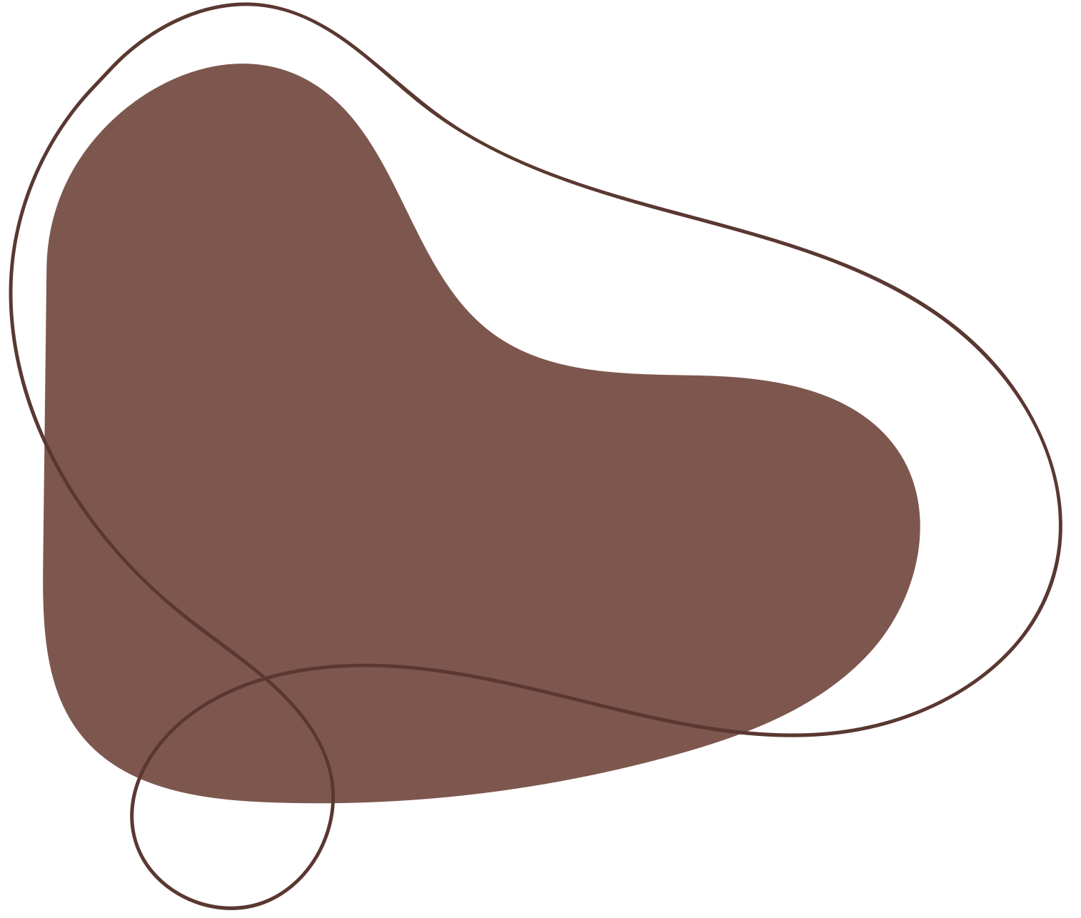






One Notebook: Document Management System
Name: Saras Chauhan
Mentor: Mr. Kamal Kumar Gola
Department: Computer Science & Engineering
College of Engineering Roorkee
Session: 2024–25

Slide 2
Abstract
One Notebook: Document Management System is a modern web-based application built using Next.js, Convex, and Clerk.
The system enables users to:
  Create, edit, and manage documents in real time
  Collaborate with multiple users simultaneously
  Experience secure and scalable document handling
Key Highlights:
  Next.js for full-stack development (frontend + backend)
  Convex for real-time data synchronization
  Clerk for secure user authentication
  Modular architecture designed for scalability and future AI integration

Slide 3
Introduction
This project addresses the growing need for a fast, collaborative, and secure document management platform.
Core Design Concepts:
  Built on Next.js for unified front-end and back-end development
  Real-time document updates via Convex
  Secure login and session management using Clerk
  Clean, intuitive, and mobile-responsive UI
  Modular architecture for easy upgrades and feature expansion
Why It Matters:
  Facilitates seamless collaboration
  Offers a user-friendly interface for all technical levels
  Lays the groundwork for future AI-enhanced functionality

Slide 4
Problem
Despite many document editing tools, common limitations persist:
Key Challenges:
  Lack of real-time collaboration
  Poor security in many open-source solutions
  Complex maintenance due to separate front-end/back-end stacks
  Non-scalable architectures that fail under multi-user loads
Project Aim:
To create a robust, real-time, secure document management system using a modern, unified tech stack that is also ready for future AI integration.

Slide 5

Technologies Used
1. Next.js
  Framework for React-based development
  Enables server-side rendering, static site generation
  Manages front-end and back-end in one codebase
2. Convex
  Real-time database
  Instantly reflects document changes for all users
  Built for collaborative apps
3. Clerk
  Secure user authentication service
  Handles sign-up, login, and session management
  Ensures only authorized access
Additional Tools:
  Vercel for deployment
  Tailwind CSS for styling
  TypeScript for type-safe development

Slide 6
Literature Review

Slide 7
Literature Review – Unified Frameworks
Unified Frameworks in Modern Web Apps:
  Traditional apps require separate front-end and back-end systems
  Unified frameworks like Next.js eliminate this separation
Benefits Highlighted in Research:
  Simplified development through a single codebase
  Improved performance with server-side rendering
  Easier maintenance and faster deployment
  Higher scalability due to consistent system logic
Application to the Project:
  Next.js forms the foundation, enabling seamless integration of logic, UI, and APIs—delivering faster and more efficient development

Slide 8
Literature Review – Real-Time Databases
Real-Time Collaboration in Web Applications:
  Traditional databases require page reloads or polling to show updates
  Real-time databases eliminate lag by pushing updates instantly
Why Convex?
  Seamless real-time integration with web apps
  Enables instant visibility of edits across users
  Built-in support for concurrent operations without performance issues
Research Insights:
  Real-time updates improve user engagement and productivity
  Essential for collaborative tools like document editors
Impact on This Project:
  Convex ensures that all users work on the latest version of documents, improving teamwork and efficiency

Slide 9
Literature Review – Authentication & Access Control
The Role of Authentication in Web Systems:
  Prevents unauthorized access
  Maintains data integrity and user trust
Why Clerk?
  Modern authentication system designed for developers
  Provides sign-up, login, session tracking, and role management
  Easy to integrate with Next.js
Literature Findings:
  Simple yet secure authentication leads to better user adoption
  Systems like Clerk are favored for their balance of usability and security
Relevance to the System:
  Clerk handles all user management, ensuring only authorized users can access or modify documents

Slide 10
Literature Review – Modular Design & Scalability
Modular Design Principles:
  Break systems into independent, reusable modules
  Enhances code clarity, testing, and future development
Benefits Highlighted in Research:
  Simplifies maintenance and debugging
  Encourages parallel development of different system parts
  Enables fast integration of new features
Application to This Project:
  UI, server logic, database, and authentication are built as separate modules
  The system is ready for scaling up or adding new features (like AI) without rewriting the entire codebase

Slide 11
Literature Review – Future Scope with AI
AI’s Emerging Role in Document Systems:
  Enhances productivity and personalization
Potential Features with AI:
  Smart suggestions for content editing
  Automatic document categorization
  Voice-to-text conversion
  Predictive document organization
Literature Trends:
  AI-driven systems are more interactive and efficient
  Adaptive UIs boost user satisfaction
Preparedness of the System:
  Modular architecture allows easy integration of AI
  Future-ready for deploying intelligent modules without affecting core features

Slide 12
Project Objectives
Unified Platform
  Use Next.js to handle both client and server in a single framework
  Reduce complexity and increase performance
Real-Time Updates
  Use Convex for live document changes
  Ensure smooth multi-user collaboration
Secure Authentication
  Integrate Clerk for protected user access
  Maintain data integrity and trustworthiness
Modular and Scalable Architecture
  Design independent system modules
  Make it easy to maintain and expand
Efficient Data Flow
  Real-time feedback loop for seamless editing
  Fast and synchronized interaction between UI, server, and database

Slide 13
Project Objectives
User-Friendly Interface
  Clean, minimal UI design
  Fully responsive for desktop, tablet, and mobile devices
  Easy navigation for users of all technical backgrounds
Future-Ready Architecture
  Designed to support upcoming features like AI modules
  Ensures smooth integration without disrupting the core system
Educational Value
  Demonstrates best practices in modern full-stack development
  Useful as a reference for students learning Next.js + Convex + Clerk
Support Collaborative Work
  Multiple users can edit/view documents simultaneously
  Promotes teamwork and real-time knowledge sharing

Slide 14
Hypothesis
A unified, real-time, and secure document management system—developed using Next.js, Convex, and Clerk—will provide a robust, scalable, and user-friendly solution for document collaboration.
Beliefs Behind the System Design:
  A single integrated platform improves performance and maintainability
  Modular design ensures long-term scalability
  Real-time updates improve user experience and productivity
  Secure authentication maintains data privacy and trust
  Future AI integration will make the system smarter and more efficient

Slide 15
Methodology
Requirement Analysis & Planning
  Define system goals and necessary tech stack
  Focus on performance, real-time collaboration, and security
System Design
  Modular structure: UI, server logic, database, authentication
  Clear separation of concerns
Implementation Phases
  UI development with responsive layout
  Backend development using Next.js API routes
  Convex integration for real-time sync
  Clerk integration for authentication
Testing & Evaluation
  Verify real-time updates, user access control, and cross-device compatibility
  Ensure modularity and code clarity

Slide 16
System Architecture
User Interface (UI)
  Clean design with core features: create, edit, share
  Responsive for all device types
Server-Side Logic (Next.js API)
  Handles business logic and routes
  Processes requests and responses efficiently
Database (Convex)
  Real-time data synchronization
  Instant document updates across sessions
Authentication (Clerk)
  Handles user login, registration, and session management
  Protects access and data integrity
Design Benefits:
  Clear modular boundaries
  Seamless interaction between components
  Easy future integration of new modules (e.g., AI)

Slide 17
Data Flow in the System
Step-by-Step Data Flow :
User Action
  A user creates or edits a document via the interface
API Request
  Next.js API receives the input and processes the update
Database Update
  Convex stores and syncs the updated data in real time
Real-Time Feedback
  UI immediately reflects the change across all users
Result:
  Live collaboration
  Smooth user experience
  Accurate and up-to-date information display at all times

Slide 18
Module

Slide 19
Module – User Interface
Objective:
Create a clean, intuitive, and responsive front end for document management.
Key Features:
  Minimalistic design focused on core functions: Create, Edit, Share
  Built using Next.js + Tailwind CSS
  Responsive layout for desktop, tablet, and mobile devices
  Real-time UI updates using Convex sync
  Simple UX suitable for users of all skill levels
Benefits:
  Easy to use
  Consistent user experience across devices
  Supports collaborative productivity

Slide 20
Module – Server-Side Logic (Next.js API)
Role of Server-Side Logic:
  Handles communication between UI and database
  Manages business logic and request validation
Built with:
  Next.js API routes
  Efficient routing and processing for operations like:
    Create/Edit/Delete document
    Fetch documents per user
    Handle errors and validation
Advantages:
  Faster load times using server-side rendering
  Single codebase simplifies maintenance
  Scalable with growing data and user base

Slide 21
Module – Database (Convex)
Purpose:
Store and sync documents in real time.
Why Convex?
  Purpose-built for real-time applications
  Pushes updates instantly to all connected users
  No need for manual refresh or polling
Document Handling:
  Supports concurrent edits
  Ensures that all users see the latest document state
  Scalable and low-latency data operations
Outcome:
Enables smooth, conflict-free live collaboration among multiple users

Slide 22
Module – Authentication (Clerk)
Functionality:
  Handles secure user registration, login, logout, and session management
  Manages access control to restrict document access to authenticated users
Features of Clerk:
  OAuth and email/password authentication
  Session tracking and token-based validation
  Easy integration with Next.js routes
Why Clerk?
  Secure yet simple for users
  Protects sensitive document data
  Enhances system trust and integrity

Slide 23
Implementation
1.Setup and Configuration
  Project initialized with Next.js
  Installed Convex and Clerk libraries
  Configured environment and routing
2.Frontend Development
  Created user interface with a focus on UX
  Integrated real-time updates and live feedback
3.Backend & API Integration
  Developed APIs to handle all CRUD operations
  Ensured efficient data validation and response handling
4.Real-Time Sync with Convex
  Connected frontend actions with Convex database
  Ensured consistent, real-time visibility for all users
5.Authentication Setup
  Implemented Clerk for secure user management
  Defined protected routes and session rules

Slide 24
Result
  Successfully implemented a unified document management system
  Real-time updates work seamlessly across all users
  Authentication is secure and stable using Clerk
  Clean and responsive UI tested on various screen sizes
  Achieved modularity: each component functions independently and efficiently

Slide 25
Conclusion
  Developed a robust, scalable, and secure document management platform
  Utilized Next.js, Convex, and Clerk to build a unified, full-stack application
  Focused on modular design, real-time updates, and user-friendly experience
  Real-time collaboration enhances productivity
  Secure authentication builds trust among users
  Clean architecture simplifies maintenance and future upgrades
The system serves as a strong example of how modern technologies can be combined to deliver a powerful, collaborative, and future-ready web application.

Slide 26
Future Scope
AI Integration:
  Smart suggestions for text formatting and content
  Voice-to-text document input
  Auto-organizing folders based on content types
Advanced Document Editor:
  More formatting tools
  Media (images, videos) embedding
  Version control and document history
Collaboration Features:
  Role-based permissions (admin, editor, viewer)
  Real-time comments and annotations
  Notifications and activity tracking
Analytics & Reporting:
  Document usage insights
  User activity logs for auditing

Slide 27
References
  Next.js Documentation
https://nextjs.org/docs
  Convex Documentation
https://docs.convex.dev
  Clerk Documentation
https://clerk.dev/docs
  Additional readings on system design, modular architecture, and real-time applications (academic and technical sources

Slide 28
Thank
You

